Slide 1

EECS 370 - Lecture 17
Cache Introduction
Live Poll + Q&A: slido.com #eecs370
Poll and Q&A Link

Slide 2
Announcements
P3 published
Checkpoint due Thursday
5% of project – have pipeline working without data hazards or branches
Midterm scores should be available later this week
HW 4 posted, due next Monday

Slide 3
Resources
Pipelining not clicking? Try playing with the "Pipeline Simulator" under "Resources" on the website
https://vhosts.eecs.umich.edu/370simulators/pipeline/simulator.html
Several pre-written programs you can step through to understand what's going on
Note that the project pipeline is slightly different

Slide 4
Project Pipeline
Design is largely the same as lecture, except no "internal forwarding" through the register file
I.e. we need to explicitly forward from a new pipeline register WBEND if source instruction is in WB while dependent is in Decode

Slide 5
Project 3 Pipeline
M
U
X
1
+
+
Register
file
M
U
X
PC
Inst
mem
Data
memory
M
U
X
A
L
U
M
U
X
Sign extend
0-2
16-18
M
U
X
IF/ID
ID/EX
EX/Mem
Mem/WB
WBEND

Slide 6
LC2K Pipeline Summary
Fetch
PC read
Decode
Execute
Need register values
Memory
Branches resolved
WB
Register values produced
Data hazards
Hazard exists if producer-consumer of a register is within a certain "window size"
Lecture 5-stage pipeline: 2 instruction window
Project 5-stage pipeline: 3 instruction window
Detect and stall – insert enough noops to separate producer and consumer
Detect and forward
For 5-stage pipeline, handles all cases except LW followed by dependent (need 1 noop)
Control hazards
Detect and stall – insert noops after IF stage
3 noops needed in our design
Detect and squash – only insert noops if we're wrong
Again, 3 needed in our design

Slide 7
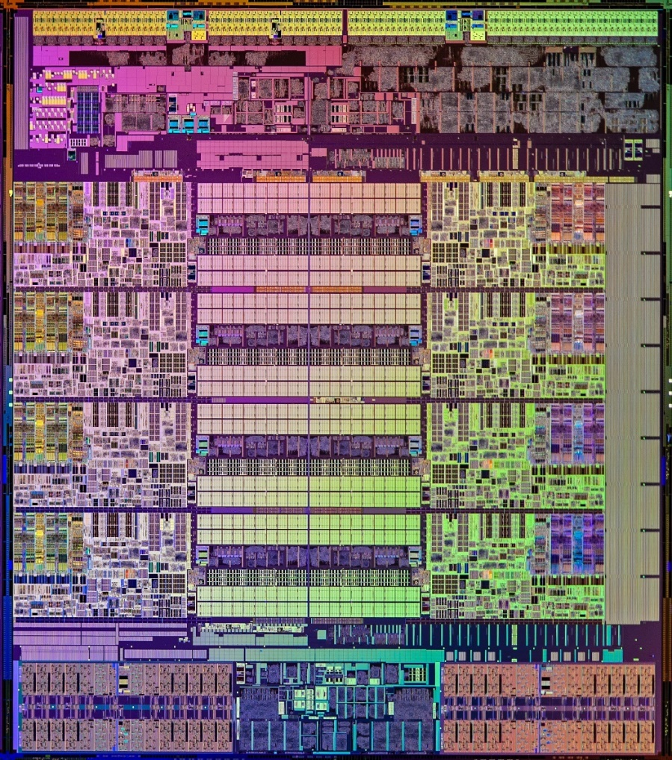
EECS 370 Overview
Part I: Software
Part II: Processor Design
Part III: Memory Design
Starting with: caches
If we judge a component's value by how much space it takes up on a chip (not a terrible heuristic), caches are very valuable
Cache

Slide 8
Cache Aware vs Non-Aware Code
Live Poll + Q&A: slido.com #eecs370
Notes:
Code on the left ends up performing better because cache ends up storing sequential memory address together (we'll understand this better in the coming weeks)

Slide 9
Memory
So far, we have discussed two structures that hold data:
Register file (little array of words)
Memory (bigger array of words)
How do we build this?
We need a lot of memory: 2¹⁸ for LC2K, a lot more for ARM
Bunch of flip-flops? Not practical – too many transistors, would be huge and power hungry
Other, clever ways of storing bits

Slide 10
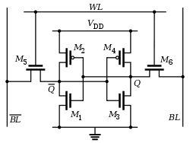
Option 1: SRAM
Each bit is made of 6 transistors
Volatile: need constant power to keep data
Fast: ~1 ns read time
Still rather large and expensive
~$5 per megabyte
Impractical to scale up to GBs needed for modern systems
Replace cost with how much we can fit on chip

Slide 11
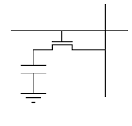
Option 2: DRAM
Each bit is made of a transistor and capacitor
Volatile: need constant power to keep data
Slower: ~50 ns access time
Must stall for dozens of cycles on each memory load
Less expensive for SRAM
~$0.004 per megabyte
We can put up to ~16 GB in current machines
Good for LC2K or 32-bit systems
But not for 64-bit systems

Slide 12
Option 3: Disks
Hard-drives store bits as magnetic charges on spinning disks
Non-volatile – holds information even when no power is supplied
Obnoxiously slow compared to digital logic: 3,000,000 ns access time
Recently, solid-state drives have replaced spinning disks with logic gates replacing mechanical systems
Also non-volatile
Much better speeds (3,000,000 ns), but still to slow to keep up with processor
Cheap!
SSDs cost $0.0001 per megabyte
Scale up to terabytes – practical for modern computing

Slide 13
Memory Goals
Fast: Ideally run at processor clock speed
1 ns access
Cheap: Ideally free
Not more expensive than rest of system
DRAM, hard-drives and SSDs are too slow
SRAM is too expensive
How to get best properties of multiple memory technologies?

Slide 14
Memory Hierarchy
Key observation: we only need to access a small amount of data at a time
Let's use a small array of SRAM to hold data we need now
Call this the cache
Able to keep up with processor
Small (~Kilobytes), so it should be relatively cheap
Use a large amount of DRAM for main memory
Can scale up to ~Gigabytes in size
Everything else, store on disk
Virtual Memory
Won't end up building 2⁶⁴ of anything
Won't be needed in typical programs
Virtual memory (discussed in a couple weeks) will make memory look larger than it is

Slide 15
Cache Analogy
Studying in the library
Option 1: Every time you grab another book, return current book to shelf and get a new book from shelf
Latency = 5 minutes
Option 2: Keep 10 commonly-used books on shelf above desk
Latency = 1 minute
Option 3: Keep 3 books open on different locations on desk
Latency = 10 seconds

Slide 16
Memory Hiearchy
Managed explicitly by programmer / compiler
Small
Regs
Fast
Managed transparently by hardware
Caches
Big
Slow
Memory

Slide 17
Caches - Overview
Memory
Memory
ld
ld
1 op / 100 cycles
1 op / 100 cycles
Cache
ld
1 op / 1 cycle
Pipeline
Pipeline

Slide 18
Function of the Cache
The cache holds the data we think is most likely to be referenced
The more often the data we want is in the fast cache, the lower our average memory access latency is
How do we decide what the most likely accessed memory locations are?

Slide 19
The simplest cache
Memory
Only worry about load instructions for now
Word-addressable address space
Consists of a single, word-size storage location to remember last loaded value
Data
Pipeline

Slide 20
The simplest cache
Memory
Whenever memory returns data, store it in the cache
We’ll also need to know what address this data corresponds to
Store that as “tag”
Also include a “valid” status bit
mem[0x09]=17
Tag | Data | Status
0x09 | 17 | Valid
ld 0x09
Pipeline

Slide 21
The simplest cache
Memory
Next memory access, first check if the tag matches address
Yes? Return cache data
No? Go to memory as before
Tag | Data | Status
0x09 | 17 | Valid
mem[0x09]=17
Pipeline
ld 0x09

Slide 22
Definitions
Hit: when data for a memory access is found in the cache
Miss: when data for a memory access is not found in the cache
Hit/Miss rate: percentage of memory accesses that hit/miss in the cache

Slide 23
Example Problem
Poll: Average access time?
Assume the following:
Cache has 1 cycle access time
If data is not found in cache, main memory is then accessed instead
Main memory has 100 cycle access time
If we have a 90% hit rate in the cache, what is the average memory latency?
1 + 0.1 * ( 100 ) = 211
Live Poll + Q&A: slido.com #eecs370

Slide 24
Scaling Up
Of course, we don't just access one memory location
What if we access many memory locations, and cache isn't large enough to hold all of them?
How do we choose what to keep in the cache?
How does hardware predict what's most likely to be needed soon?
Answer: locality
Temporal locality
Spatial locality

Slide 25
Temporal Locality
Temporal locality: if a given memory location is referenced now, it will probably be used again in the near future
Why? Take a look at code you've written. You tend to use a variable multiple times
Corollary: if you haven't used a variable in a while, you probably won't need it very soon either
Hardware should take advantage of this by:
Placing items we just accessed in the cache
When we need to evict something, evict whatever data was least recently used (LRU)

Slide 26
A Very Simple Memory System
Processor
Cache
Memory
2 cache lines
4 bit tag field
1 byte block
0
1
2
3
4
5
6
7
8
9
10
11
12
13
14
15
74
110
120
Ld R1 ← M[ 1 ]
Ld R2 ← M[ 5 ]
Ld R3 ← M[ 1 ]
Ld R3 ← M[ 7 ]
Ld R2 ← M[ 7 ]
130
140
V
150
V
160
tag data
170
180
190
200
R0
R1
R2
R3
210
220
230
240
250

Slide 27
A Very Simple Memory System
Processor
Cache
Memory
0
1
2
3
4
5
6
7
8
9
10
11
12
13
14
15
74
Is it in the cache?
110
No valid tags
120
Ld R1 ← M[ 1 ]
Ld R2 ← M[ 5 ]
Ld R3 ← M[ 1 ]
Ld R3 ← M[ 7 ]
Ld R2 ← M[ 7 ]
130
140
1
1
110
0
150
0
160
tag data
170
180
This is a
Cache miss
190
200
R0
R1
R2
R3
210
Allocate: address → tag
Mem[1] → block
220
230
240
250

Slide 28
A Very Simple Memory System
Processor
Cache
Memory
0
1
2
3
4
5
6
7
8
9
10
11
12
13
14
15
100
74
110
120
Ld R1 ← M[ 1 ]
Ld R2 ← M[ 5 ]
Ld R3 ← M[ 1 ]
Ld R3 ← M[ 7 ]
Ld R2 ← M[ 7 ]
130
140
1
1
110
150
lru
0
160
tag data
170
180
190
200
R0
R1
R2
R3
210
110
Misses: 1
Hits: 0
220
230
240
250

Slide 29
A Very Simple Memory System
Tag comparison uses hardware called "content-addressable memory (CAM)"
Processor
Cache
Memory
0
1
2
3
4
5
6
7
8
9
10
11
12
13
14
15
100
74
Check tags: 5 ≠ 1
110
120
Cache Miss
Ld R1 ← M[ 1 ]
Ld R2 ← M[ 5 ]
Ld R3 ← M[ 1 ]
Ld R3 ← M[ 7 ]
Ld R2 ← M[ 7 ]
130
140
1
1
110
150
lru
1
5
150
0
160
tag data
170
180
190
200
R0
R1
R2
R3
210
110
Misses: 1
Hits: 0
220
230
240
250

Slide 30
A Very Simple Memory System
Processor
Cache
Memory
0
1
2
3
4
5
6
7
8
9
10
11
12
13
14
15
100
74
110
120
Ld R1 ← M[ 1 ]
Ld R2 ← M[ 5 ]
Ld R3 ← M[ 1 ]
Ld R3 ← M[ 7 ]
Ld R2 ← M[ 7 ]
130
140
lru
1
1
110
150
1
5
150
160
tag data
170
180
190
200
R0
R1
R2
R3
210
110
Misses: 2
Hits: 0
220
150
230
240
250

Slide 31
A Very Simple Memory System
Processor
Cache
Memory
0
1
2
3
4
5
6
7
8
9
10
11
12
13
14
15
100
74
Check tags: 1 ≠ 5,
but 1 = 1 (HIT!)
110
120
Ld R1 ← M[ 1 ]
Ld R2 ← M[ 5 ]
Ld R3 ← M[ 1 ]
Ld R3 ← M[ 7 ]
Ld R2 ← M[ 7 ]
130
140
lru
1
1
110
150
1
5
150
160
tag data
170
180
190
200
R0
R1
R2
R3
210
110
Misses: 2
Hits: 0
220
150
230
240
250

Slide 32
A Very Simple Memory System
Processor
Cache
Memory
0
1
2
3
4
5
6
7
8
9
10
11
12
13
14
15
100
74
110
120
Ld R1 ← M[ 1 ]
Ld R2 ← M[ 5 ]
Ld R3 ← M[ 1 ]
Ld R3 ← M[ 7 ]
Ld R2 ← M[ 7 ]
130
140
1
1
110
150
lru
1
5
150
160
tag data
170
180
190
200
R0
R1
R2
R3
210
110
Misses: 2
Hits: 1
220
150
230
110
240
250

Slide 33
A Very Simple Memory System
Processor
Cache
Memory
0
1
2
3
4
5
6
7
8
9
10
11
12
13
14
15
100
74
110
120
Ld R1 ← M[ 1 ]
Ld R2 ← M[ 5 ]
Ld R3 ← M[ 1 ]
Ld R3 ← M[ 7 ]
Ld R2 ← M[ 7 ]
130
140
1
1
110
150
lru
1
5
150
160
tag data
170
180
190
200
R0
R1
R2
R3
210
110
Misses: 2
Hits: 1
220
150
230
110
240
250

Slide 34
A Very Simple Memory System
Processor
Cache
Memory
0
1
2
3
4
5
6
7
8
9
10
11
12
13
14
15
100
74
7 ≠ 5 and 7 ≠ 1
(MISS!)
110
120
Ld R1 ← M[ 1 ]
Ld R2 ← M[ 5 ]
Ld R3 ← M[ 1 ]
Ld R3 ← M[ 7 ]
Ld R2 ← M[ 7 ]
130
140
1
1
110
150
lru
5
7
150
1
170
160
tag data
170
180
190
200
R0
R1
R2
R3
210
110
Misses: 2
Hits: 1
220
150
230
110
170
240
250

Slide 35
A Very Simple Memory System
Processor
Cache
Memory
0
1
2
3
4
5
6
7
8
9
10
11
12
13
14
15
100
74
110
120
Ld R1 ← M[ 1 ]
Ld R2 ← M[ 5 ]
Ld R3 ← M[ 1 ]
Ld R3 ← M[ 7 ]
Ld R2 ← M[ 7 ]
130
140
lru
1
1
110
150
1
7
170
160
tag data
170
180
190
200
R0
R1
R2
R3
210
110
Misses: 3
Hits: 1
220
150
230
170
240
250

Slide 36
A Very Simple Memory System
Processor
Cache
Memory
0
1
2
3
4
5
6
7
8
9
10
11
12
13
14
15
100
74
7 ≠ 1 and 7 = 7
(HIT!)
110
120
Ld R1 ← M[ 1 ]
Ld R2 ← M[ 5 ]
Ld R3 ← M[ 1 ]
Ld R3 ← M[ 7 ]
Ld R2 ← M[ 7 ]
130
140
lru
1
1
110
150
1
7
170
160
tag data
170
180
190
200
R0
R1
R2
R3
210
110
Misses: 3
Hits: 1
220
150
170
230
170
240
250

Slide 37
A Very Simple Memory System
Processor
Cache
Memory
0
1
2
3
4
5
6
7
8
9
10
11
12
13
14
15
100
74
110
120
Ld R1 ← M[ 1 ]
Ld R2 ← M[ 5 ]
Ld R3 ← M[ 1 ]
Ld R3 ← M[ 7 ]
Ld R2 ← M[ 7 ]
130
140
lru
1
1
110
150
1
7
170
160
tag data
170
180
190
200
R0
R1
R2
R3
210
110
Misses: 3
Hits: 2
220
170
230
170
240
250

Slide 38

Next time
Making our caches bigger and better
Lingering questions / feedback? I'll include an anonymous form at the end of every lecture: https://bit.ly/3oXr4Ah

Slide 40
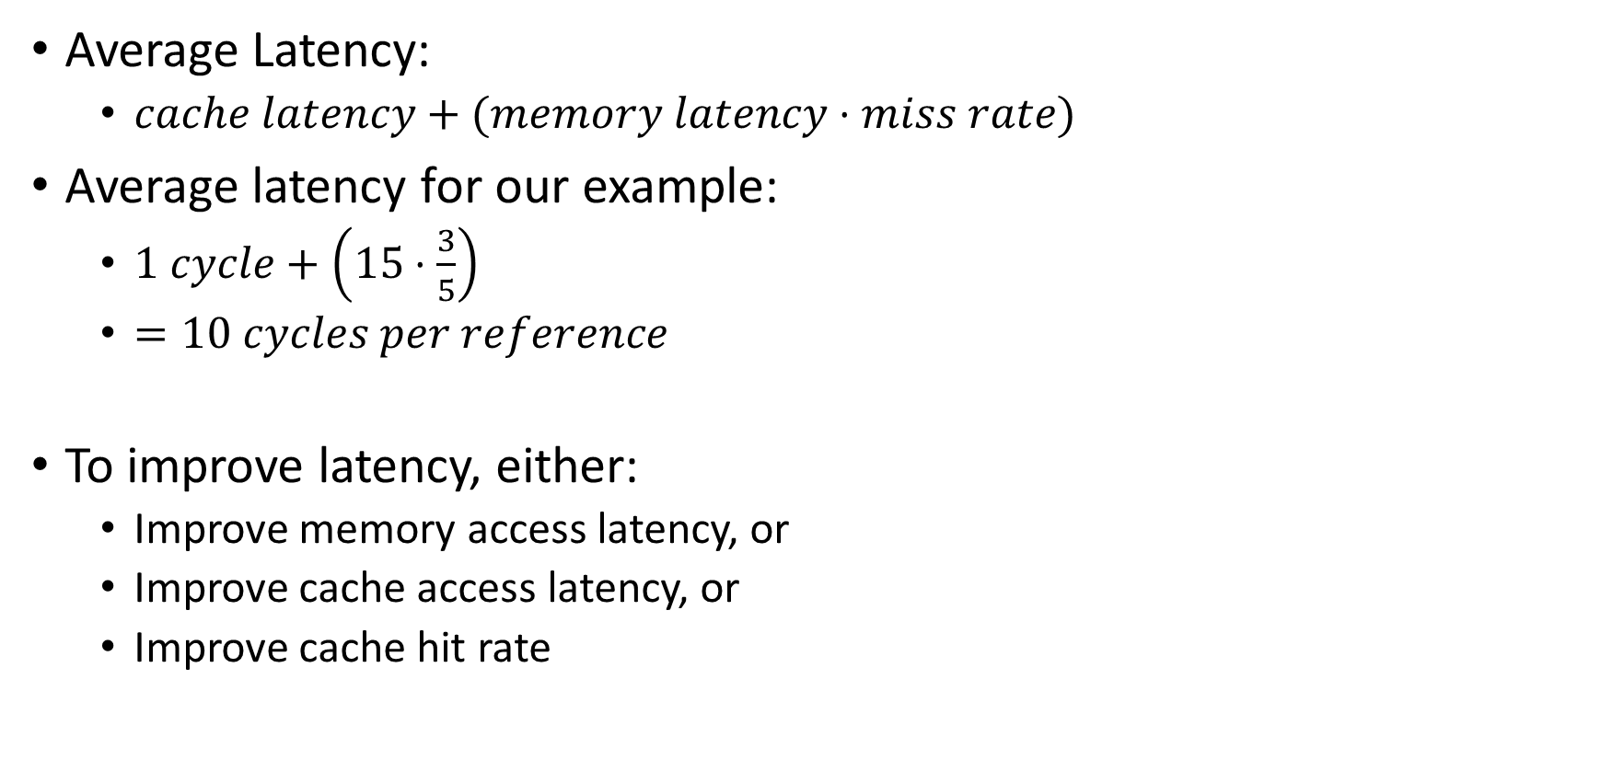
Calculating Average Access Latency
Average Latency:
$cache latency+(memory latency⋅miss rate)$
Average latency for our example:
$1 cycle+\left(15⋅\frac{3}{5}\right)$
$=10 cycles per reference$
To improve latency, either:
Improve memory access latency, or
Improve cache access latency, or
Improve cache hit rate

Slide 41
Calculating Size
How many bits is used in cache?
Storing data
2 bytes of SRAM
Calculate overhead (non-data)
This cost is often forgotten for caches, but it drives up the cost of real designs!
2 4-bit tags
2 valid bits
What is the storage requirement
Poll: Which of the following would reduce tag overhead (as an overall percentage)? (select all that apply)
Increase number of cache entries
Decrease number of cache entries
Use smaller addresses
Store more data in each cache entry
Live Poll + Q&A: slido.com #eecs370

Slide 42
How can we reduce overhead?
Have a smaller address
Impractical, and caches are supposed to be micro-architectural
Cache bigger units than bytes
Each block has a single tag, and blocks can be whatever size we choose.
lru
1
1
110
1
7
170
tag data

Slide 43
Increasing Block Size
Memory
Tag
(case 1)
Tag
(case 2)
0
1
2
3
4
5
6
7
8
9
10
11
12
13
14
15
74
0
1
2
3
4
5
6
7
8
9
10
11
12
13
14
15
0
0
1
1
2
2
3
3
4
4
5
5
6
6
7
7
110
Case 1:
Block size: 1 bytes
120
1
0
74
1
6
160
130
V tag data (block)
140
How many bits needed per tag?
= log₂(number of blocks in memory) = log₂(16)
= 4 bits
Overhead = (4+1) / 8 = 62.5%
150
160
170
180
190
1
0
74
110
200
Case 2:
Block size: 2 bytes
1
3
160
170
210
V tag data (block)
220
230
How many bits needed per tag?
= log₂(number of blocks in memory) = log₂(8)
= 3 bits
Overhead = (3+1) / 16 = 25%
240
250
Poll: What will the overhead of this cache be?
Live Poll + Q&A: slido.com #eecs370

Slide 44
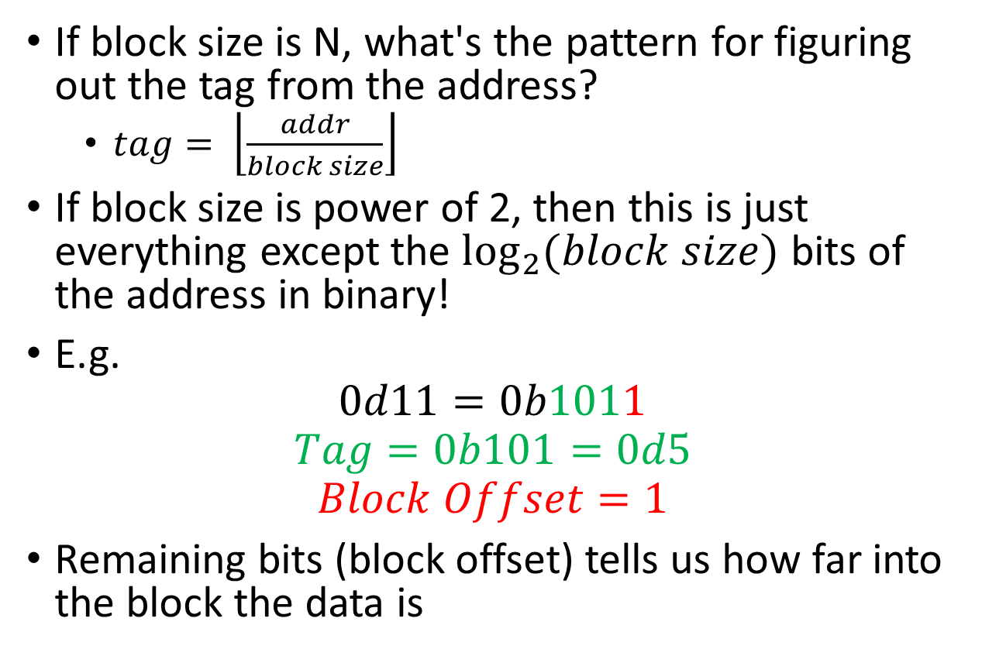
Figuring out the tag
Memory
Tag
(case 2)
0
1
2
3
4
5
6
7
8
9
10
11
12
13
14
15
74
0
0
1
1
2
2
3
3
4
4
5
5
6
6
7
7
110
Poll: What's the pattern?
120
If block size is N, what's the pattern for figuring out the tag from the address?
$tag= \left\lfloor \frac{addr}{block size}\right\rfloor$
If block size is power of 2, then this is just everything except the $\log_{2}{(block size)}$ bits of the address in binary!
E.g.
$$0d11=0b1011$$
$$Tag=0b101=0d5$$
$$Block Offset=1$$
Remaining bits (block offset) tells us how far into the block the data is
130
140
150
160
170
180
190
200
210
220
230
240
250
Live Poll + Q&A: slido.com #eecs370

